Slide 1

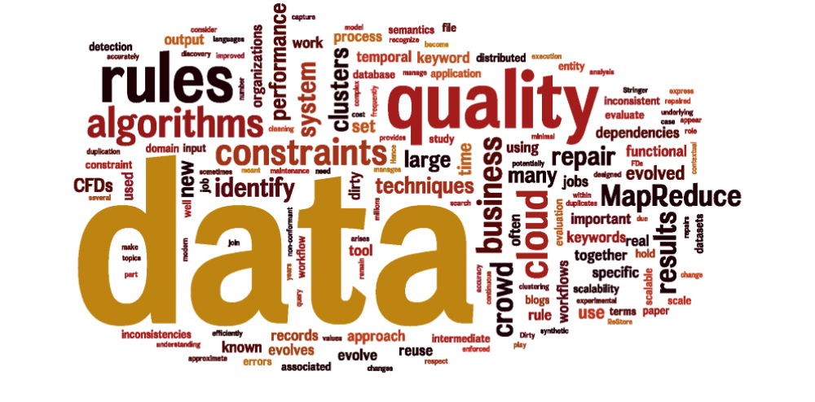
Computational Structures in Data Science
Lecture #1: Welcome to CS88!
UC Berkeley EECS Adj. Ass. Prof. Dr. Gerald Friedland
January 28, 2019
http://inst.eecs.berkeley.edu/~cs88

Slide 2
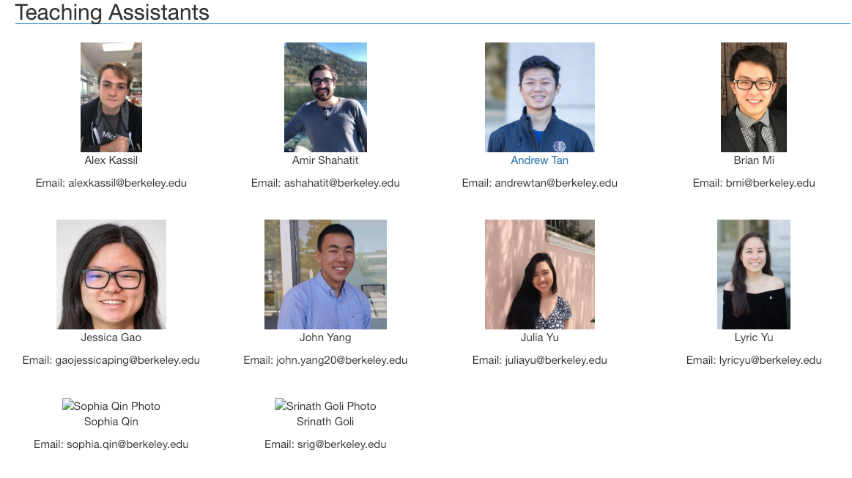
CS88 Team
UCB CS88 Sp19 L1

Slide 3
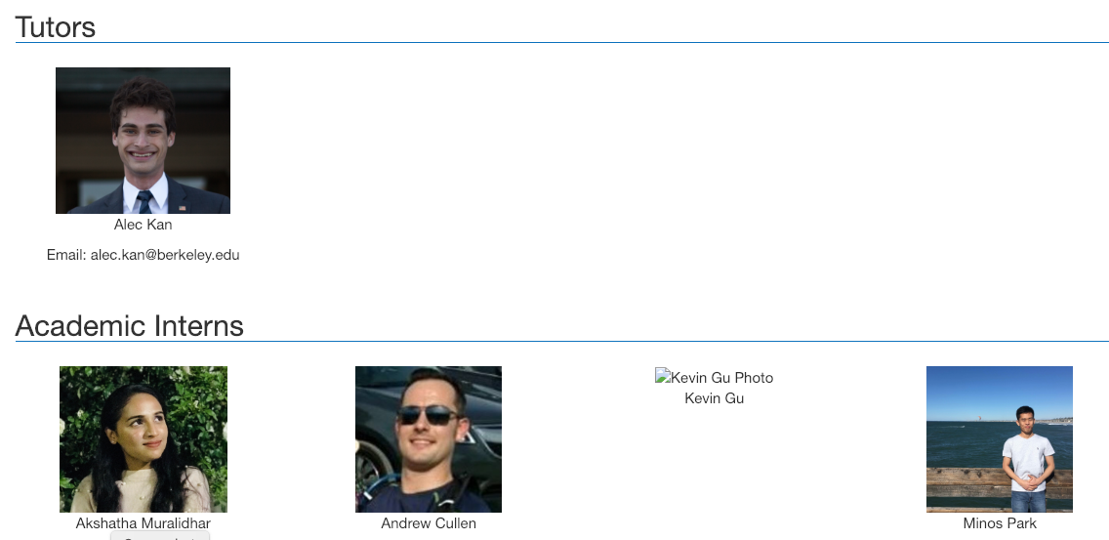
CS88 Team
UCB CS88 Sp19 L1

Slide 4


CS88 Team - me
Dr. Gerald Friedland (fractor@berkeley.edu)
424 Saturdai Daj Hall (CITRIS)
http://www.gerald-friedland.org
Office hours: Mo 1:30-2:30 @ 424 SDH
Before/after class
Adjunct Assistant Professor, EECS UC Berkeley
Principal Data Scientist, Lawrence Livermore National Laboratories
UCB CS88 Sp19 L1

Slide 5


CS88 Team - me
Projects you might want to check out:
http://mmcommons.org
Work with 100M images, 1M videos
in your own Amazon instance.
http://www.teachingprivacy.org
- Creating teaching materials informing about data over sharing.
UCB CS88 Sp19 L1

Slide 6
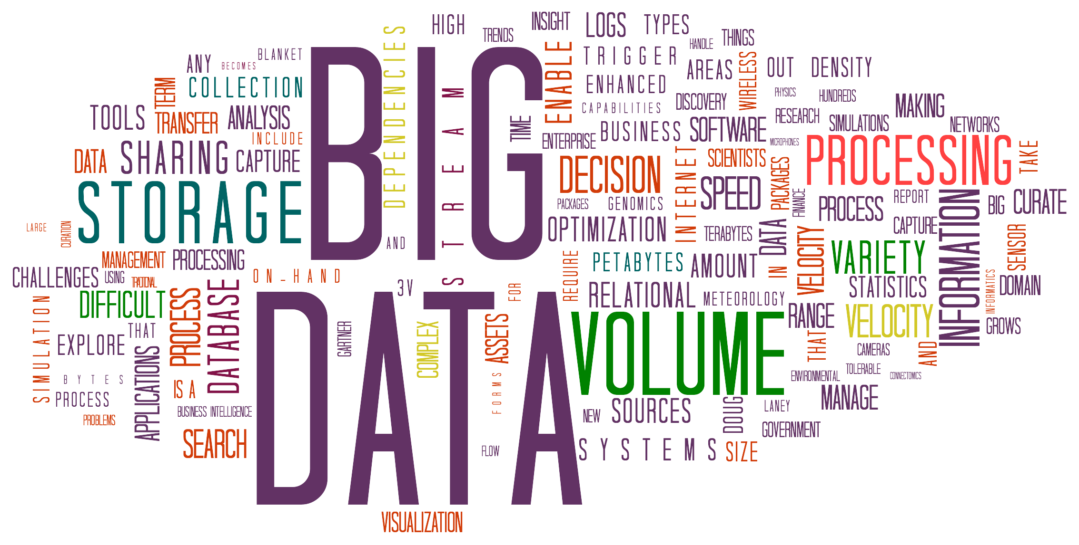

Goals today
Introduce you to
the field
the course
the team
Answer your questions
Big Ideas:
Abstraction
Data Type
UCB CS88 Sp19 L1
Notes:
Questions:
- Freshman/Soph vs Jr/Sen
- New to programming vs experienced
- CS10
- CS61A
- Might want to major? Minor? Just do some CS?
- Love c8 so far?

Slide 7
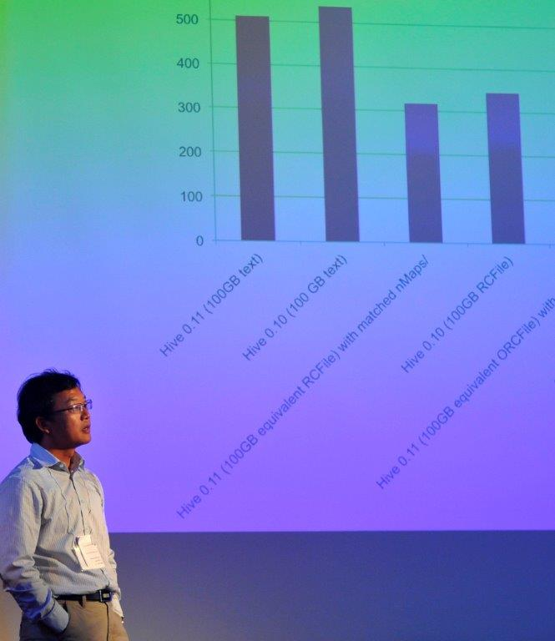
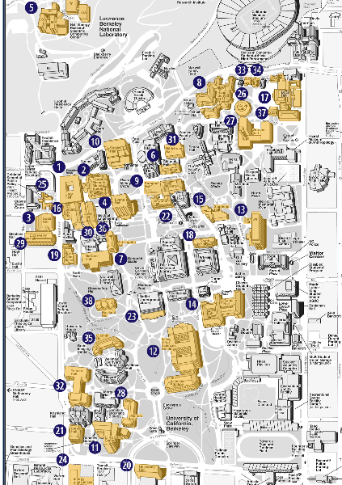
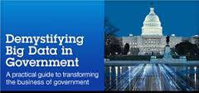
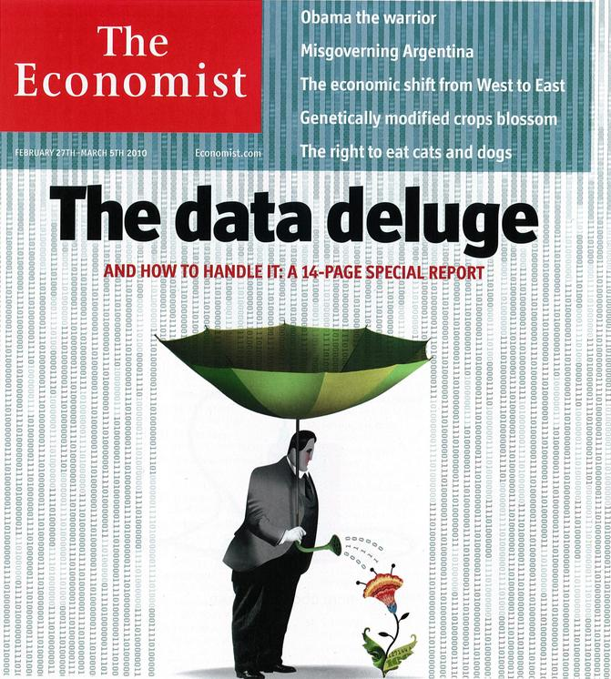
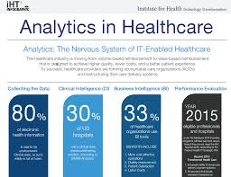
Data Science
UCB CS88 Sp19 L1

Slide 8
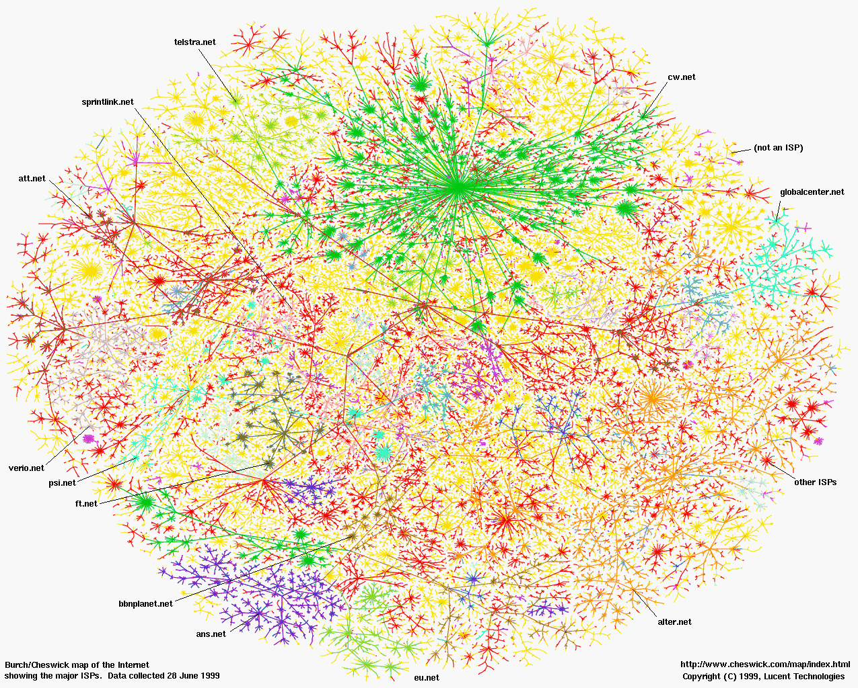
Greatest Artifact of Human Civilization …
UCB CS88 Sp19 L1

Slide 9
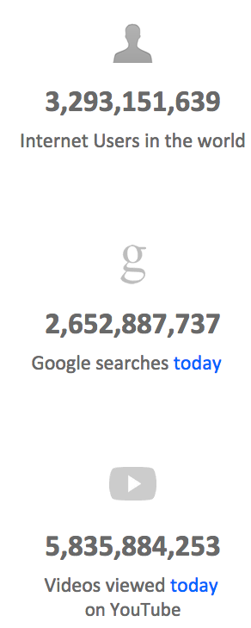

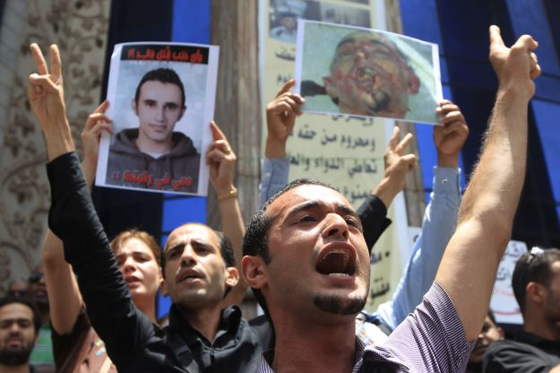
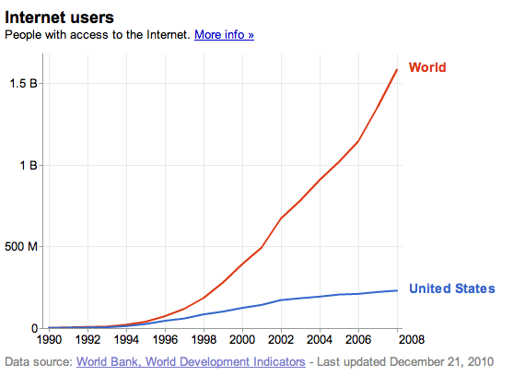
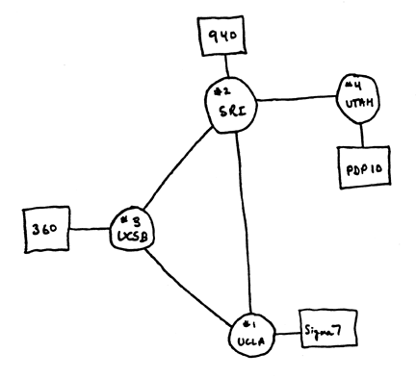
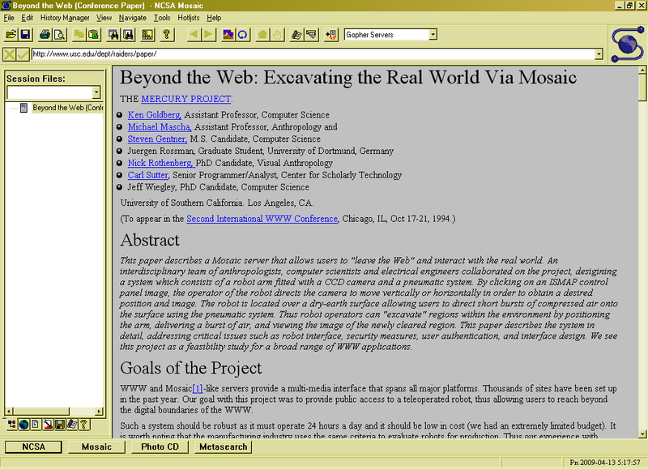
A Connected World
3.0 B 11/15
Internet
WWW
2.0 B 1/26/11
ARPANet
RFC 675 TCP/IP
HTTP 0.9
1969
1974
1990
2010
UCB CS88 Sp19 L1

Slide 10
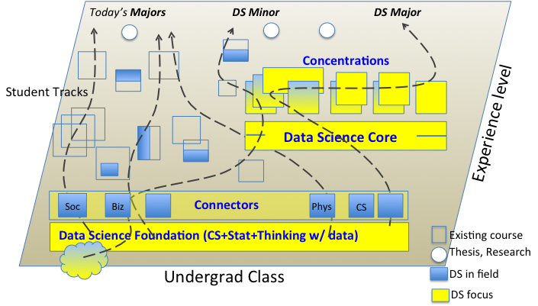
Data 8 – Foundations of Data Science
Computational Thinking + Inferential Thinking in the context of working with real world data
Introduce you to several computational concepts in a simple data-centered setting
Authoring computational documents
Tables
Within Python3 and “SciPy”
UCB CS88 Sp19 L1

Slide 11
CS88 – Computational Structures in Data Science
Deeper understanding of the computing concepts introduced in c8
Hands-on experience => Foundational Concept
How would you create what you use in c8 ?
Extend your understanding of the structure of computation
What is involved in interpreting the code you write ?
Deeper CS Concepts: Recursion, Objects, Classes, Higher-order Functions, Declarative programming, …
Managing complexity in creating larger software systems through composition
Create complete (and fun) applications
In a data-centric approach
UCB CS88 Sp19 L1

Slide 12
Pathways
c8
c8
cs88
c8
cs88
cs47a
cs61b
***
CS major
c8
cs61a
cs61a
UCB CS88 Sp19 L1

Slide 13
How does CS88 relate to CS61A ?
Interpretation
Thinking w/ Data
Working w/ Data
CS Concepts
and
Techniques
Statistics Concepts in a Computational Approach
CS Concepts
and
Techniques
Units
& Tools
Intro Programming
& Tools
Intro Programming
CS61A
CS/INFO/STAT c8
CS88
UCB CS88 Sp19 L1
Notes:
Cascade
C8
C8 + CS 88
C8 + CS88 + CS61B
CS minor
CS Major

Slide 14
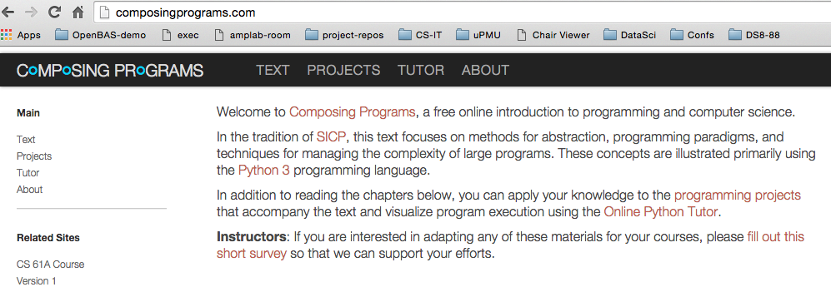
Course Structure
1 Lecture + 1 Lab/Discussion on Wednesday (!!!)
Lecture introduces concepts (quickly!), answers why questions.
Lab provides concrete detail hands-on
Homework (10) cements your understanding
Out Monday, Due Sunday
Projects (3) put your understanding to work in building complete applications
Maps
Hangman
Open Projects!
Readings: http://composingprograms.com
Same as cs61a
UCB CS88 Sp19 L1
Notes:
Course Policies:
- Learning: The purpose of this course is to learn something you don't
already know.
You should never feel bad for not understanding something yet.
I won't tolerate disrespectful or condescending comments.
If someone doesn't understand something, help them out.
- Community: You're encouraged to help each other;
One of the most important things you can learn in college is how to explain
- Course Staff: We are here to help you succeed, not to judge you.
We know that you're talented b/c you're at Berkeley
We know that you're able to work hard, and we're here to make
sure that working hard leads to the results you want.

Slide 15
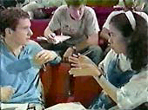
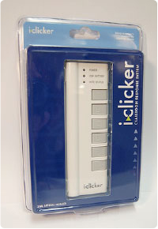
Course Culture
Learning
Community
Respect
Collaboration
Peer Instruction
UCB CS88 Sp19 L1

Slide 16
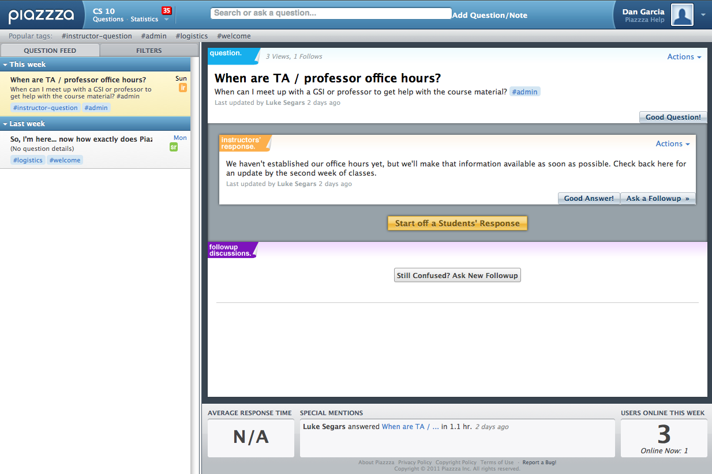
Piazza for {ask,answer}ing questions
UCB CS88 Sp19 L1

Slide 17
Where will we work?
Datahub.berkeley.edu
Your laptop
Inst.eecs.Berkeley.edu
UCB CS88 Sp19 L1

Slide 18
Pro-student Grading Policies
EPA
Rewards good behavior
Effort
E.g., Office hours, doing every single lab, hw, reading Piazza pages
Participation
E.g., Raising hand in lec or discussion, asking questions on Piazza
Altruism
E.g., helping other students in lab, answering questions on Piazza
You have 2 “Slip Days”
You use them to extend due date, 1 slip day for 1 day extension
You can use them one at a time or all at once or in any combination
They follow you around when you pair up (you are counted individually)
E.g., A has 2, B has 0. Project is late by 1 day. A uses 1, B is 1 day late

Slide 19

Abstraction
Detail removal
“The act of leaving out of consideration one or more properties of a complex object so as to attend to others.”
Generalization
“The process of formulating general concepts by abstracting common properties of instances”
Technical terms: Compression, Quantization, Clustering, Unsupervized Learning
Henri Matisse “Naked Blue IV”

Slide 20
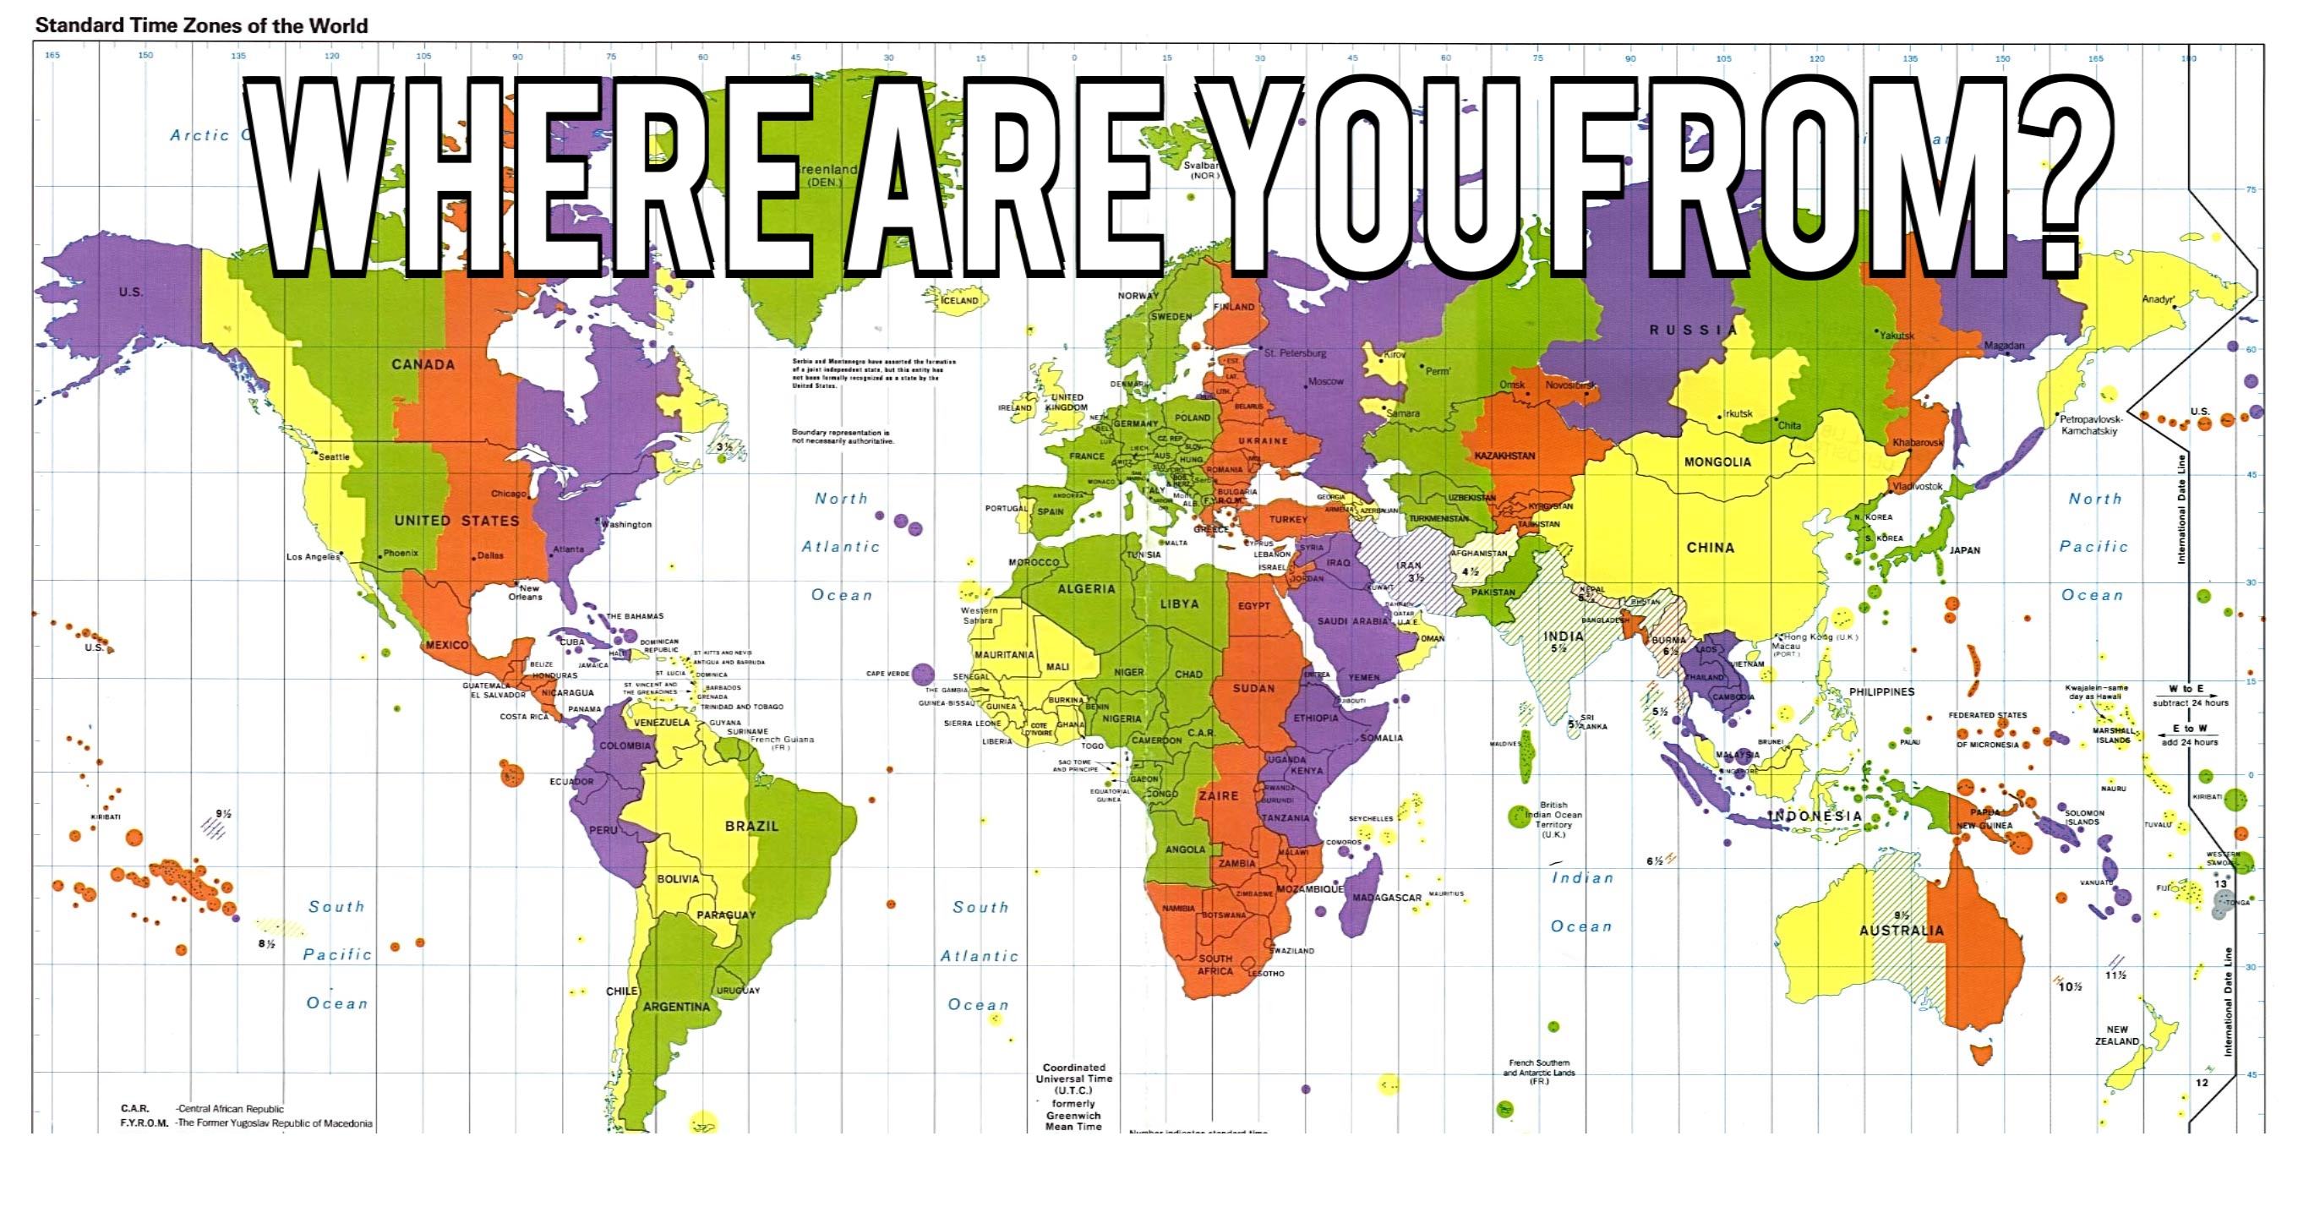
Experiment

Slide 21

Where are you from?
Possible Answers:
China
California
The Bay Area
San Mateo
1947 Center Street, Berkeley, CA
37.8693° N, 122.2696° W
All correct but different levels of abstraction!

Slide 22
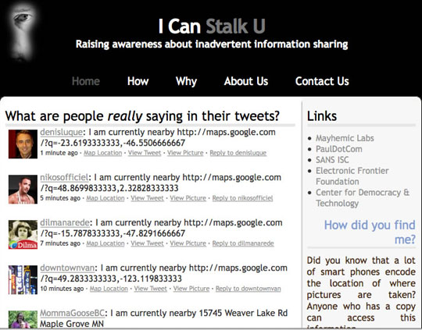
Abstraction gone wrong!

Slide 23
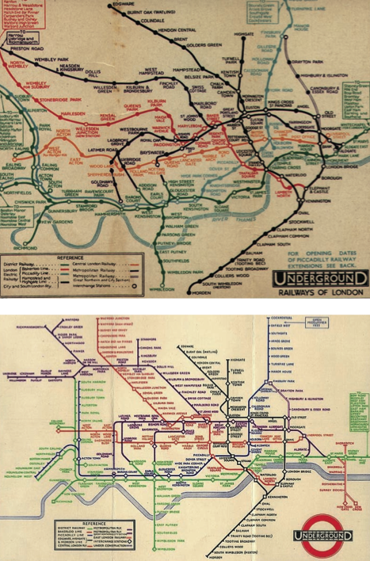
Detail Removal (in Data Science)
You’ll want to look at only the interesting data, leave out the details, zoom in/out…
Abstraction is the idea that you focus on the essence, the cleanest way to map the messy real world to one you can build
Experts are often brought in to know what to remove and what to keep!
The London Underground 1928 Map & the 1933 map by Harry Beck.

Slide 24
The Power of Abstraction, Everywhere!
Examples:
Functions (e.g., sin x)
Hiring contractors
Application Programming Interfaces (APIs)
Technology (e.g., cars)
Amazing things are built when these layer
And the abstraction layers are getting deeper by the day!
We only need to worry about the interface, or specification, or contract
NOT how (or by whom) it’s built
Above the abstraction line
Abstraction Barrier (Interface) (the interface, or specification, or contract)
Below the abstraction line
This is where / how / when / by whom it is actually built, which is done according to the interface, specification, or contract.

Slide 25
Abstraction: Pitfalls
Abstraction is not universal without loss of information (mathematically provable). This means, in the end, the complexity can only be “moved around”
Abstraction makes us forget how things actually work and can therefore hide bias. Example: AI and hiring decisions.
Abstraction makes things special and that creates dependencies. Dependencies grow longer and longer over time and can become unmanageable.

Slide 26
Abstraction in CS: Data Type
What’s this?
Real (or ideal) world
42
Computer representation
Notes:
Integers?, Whole Numbers?, Natural Numbers
What other data types are you already familiar with?
- rational
- reals
- complex
- strings
Which real numbers can you represent?

Slide 27
Data Types and Operations
Set of elements
with some internal representation
E.g. Integers, Floats, Booleans, Strings, …
Set of operations on elements of the type
e.g. +, *, -, /, %, //, **
==, <, >, <=, >=
Properties
Commutative, Associative, … , Closure (???)
Expressions are valid well-defined sets of operations on elements that produce a value of a type
Notes:
Python

Slide 28
Lab and HW this week
Lab will get you to where you have a program development environment
Even on your computer
HW will give practice and explain subtleties of types, operators, and expressions
In a program development environment
What’s the difference between ‘==‘ and ‘=‘ ?
UCB CS88 Sp19 L1

Slide 29
Thoughts for the Wandering Mind
A binary digit (bit) is a symbol from {0,1}.
How many strings can you represent with N bits?
Could you build a program that compresses all strings of N bits to strings of M bits (with M<N) such that you can go back to all original strings of length N? How or Why?
UCB CS88 Sp19 L1

